Slide 1
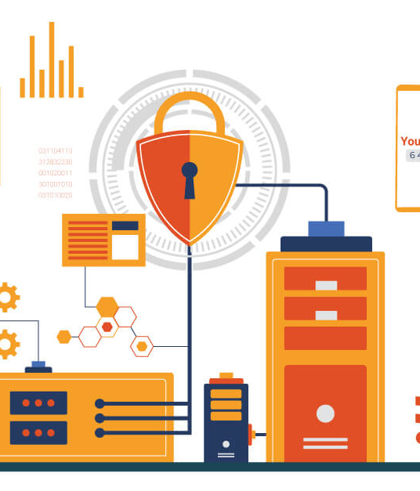
Hands-On Application Security Testing: From Automation to Exploitation
This slide explores the full spectrum of Dynamic Application Security Testing (DAST), blending automated WebInspect scanning, manual BurpSuite testing, and custom hands-on labs. Attendees will learn to leverage a diverse toolkit to identify and exploit real-world web vulnerabilities, from discovering weaknesses to crafting effective remediations.

Slide 2




Evolving Application Vulnerability Scanning
AUTOMATED VULNERABILITY SCANNING WITH WEBINSPECT
MANUAL PENETRATION TESTING WITH BURPSUITE
COMPREHENSIVE REMEDIATION ADVISORIES
COMPENSATING CONTROLS WITH WEB APPLICATION FIREWALL (WAF)
I used WebInspect to automate the scanning of web applications for a wide range of vulnerabilities, including cross-site scripting (XSS), SQL injection, and unpatched software. By integrating automated scanning into our workflows, I was able to quickly identify and prioritize security issues across the application portfolio.
In addition to automation, I performed manual penetration testing with BurpSuite. I developed and applied custom testing techniques to uncover complex vulnerabilities, conduct deeper analysis, and validate the effectiveness of remediation strategies.
I also created remediation guidance for developers, providing detailed explanations of the root causes of vulnerabilities and recommending specific code changes or configuration updates.
As a final layer of defense, I configured compensating controls within the Web Application Firewall (WAF). This helped detect and mitigate known vulnerabilities and attack patterns, ensuring applications remained protected while long-term fixes were being implemented.

Slide 3
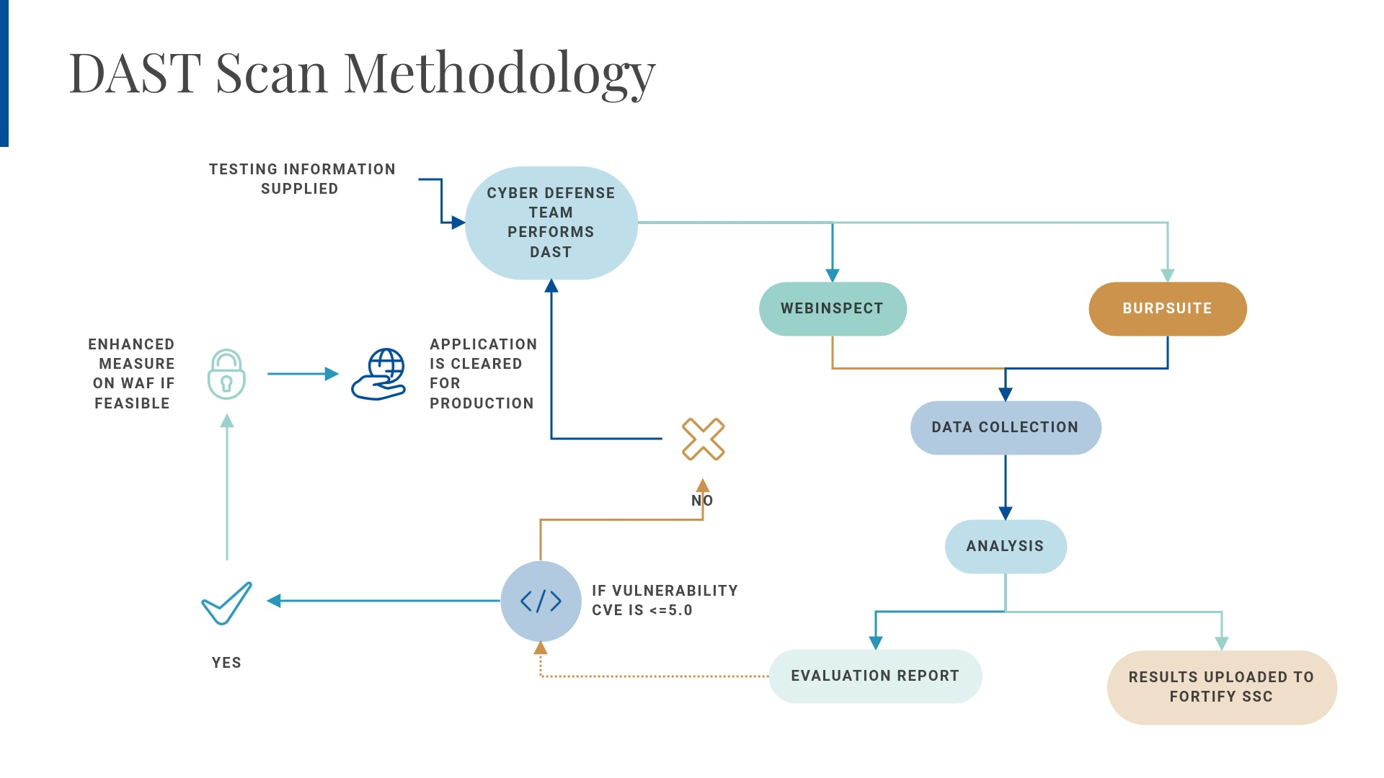
Notes:
Here you can see our dynamic scan methodology. The diagram is a simplified version of our compliance documentation. We start by testing the information provided by the development team (such as the URL and credentials). We then load that information to begin the preliminary scan using WebInspect and BurpSuite (the testing tools). Once the data is collected, the analysis phase begins using BurpSuite interceptor tools and custom scripts. The analysis is then uploaded to the Sofware Security Centre and included in the evaluation report. If a vulnerability's CVE score is less than 5 on the CVE scoring system, we evaluate whether compensating controls within the WAF are necessary and then send the information to the developers.
The "No" arrow is actioned if the developers request a rescan. Since it is not mandated that a dynamic scan rescan be completed within the application development cycle, it is handled on a case-by-case basis.
We have had some applications that requested a rescan, at which point we begin the process anew. So to recap, we start with basic information from developers, use fancy tools to find issues, and then analyze the results. Serious problems are flagged and either fixed with extra protections (if needed) or shared with developers for action.
If developers ask for another scan, we’re flexible and can repeat the process. This step-by-step approach ensures that apps are as secure as possible before going live.

Slide 4

Application Vulnerability Labs: Dynamic Application Security Testing
Application Vulnerability Labs provides hands-on labs for exploring real-world web vulnerabilities. Dive into automated scanning, manual testing, and effective remediation strategies to enhance your cybersecurity skills.

Slide 5
Weak TLS Cipher Acceptance (CipherCheckTestLab)
WEAK TLS CIPHER ACCEPTANCE
Vulnerability: Weak SSL/TLS ciphers accepted by server – allows downgrade of encryption. Server misconfiguration may permit using obsolete cipher suites (e.g., 40-bit or RC4), risking exposure of sensitive data.
POC TOOL: CUSTOM BASH SCRIPT USING CURL --CIPHERS OPTION
Tests various cipher suites against the target. Automates checks across many ciphers (from strong to very weak) and logs which ones are accepted.
INJECTION FEATURES: SUPPORTS COOKIE AND URL INJECTION
Tester can specify a session cookie to simulate an authenticated user, and target specific URLs (endpoints) on the site. Ensures even pages requiring login can be tested for weak cipher enforcement.
OUTCOME: IF THE SERVER NEGOTIATES ANY DEPRECATED CIPHER
The script flags it. This confirms the server can be tricked into using a cipher that should be disallowed, potentially enabling attackers to decrypt or manipulate supposedly secure sessions.
REMEDIATION: DISABLE LEGACY CIPHERS ON THE SERVER SIDE
Enforce minimum TLS version and strong cipher suites (follow industry recommendations to prevent downgrade attacks).

Slide 6
Clickjacking Framing Attack (clickjacking-lab)
VULNERABILITY: CLICKJACKING (UI REDRESSING)
The attack page frames the target website and tricks the user into clicking invisible or disguised elements. The user believes they are interacting with the visible page, but their clicks are actually performing actions on the hidden target frame.
LAB SETUP: MALICIOUS HTML PAGE WITH
The iframe is styled (with CSS opacity or stacking) so that a critical action button on the target is positioned under a seemingly benign clickable element on the top page.
COOKIE INJECTION: PROGRAMMATICALLY SET SESSION COOKIE
The attacker's page can set or instruct the victim to set a session cookie for the target site, so that the framed action (e.g., "Delete Account") will execute as if the user was logged in.
DEMONSTRATED IMPACT: UNAUTHORIZED ACTIONS ON USER ACCOUNT
Without defenses like X-Frame-Options or frame-busting scripts, an attacker can force a user to perform unauthorized actions on their account, such as clicking a "Transfer Funds" button on the hidden bank site frame.
MITIGATIONS: DEVELOPERS SHOULD USE X-FRAME-OPTIONS, CSP
Developers should send the X-Frame-Options: DENY or SAMEORIGIN header, use the newer Content-Security-Policy: frame-ancestors directive, and ensure critical UI actions have additional confirmation.

Slide 7
HTTP Request Smuggling (Conflicting CL/TE) – WebInspect Lab
VULNERABILITY: HTTP REQUEST SMUGGLING
Exploiting inconsistent parsing of request boundaries by front-end vs. back-end servers. Including both Content-Length and Transfer-Encoding: chunked headers creates ambiguity in how the request is processed.
TECHNIQUE: CRAFTED HTTP MESSAGE WITH DECEPTIVE BODY
The attack uses a crafted HTTP message with a deceptive body that actually contains a second, smuggled HTTP request.
FRONT-END VS. BACK-END PROCESSING DISCREPANCY
The front-end (e.g., proxy, load balancer) uses one header to determine request length while the back-end uses the other, causing them to see different requests.
IMPACT: BYPASSING SECURITY CONTROLS
The successful exploit allows the attacker to inject a hidden request that the back-end will process as a separate HTTP request, bypassing security checks.
POTENTIAL IMPACTS
This can let the attacker steal data or perform actions in another user's session, effectively breaking the normal request isolation on the server.
REMEDIATION
Reject or properly handle ambiguous requests, update proxies/servers to the latest versions with known fixes, and ensure the front-end removes one of the headers when both are present.

Slide 8
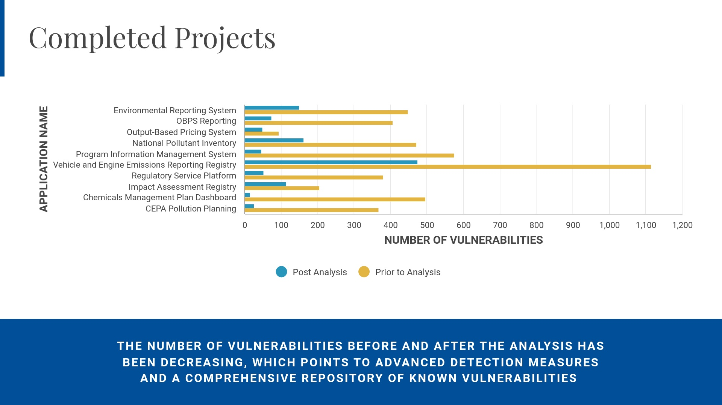
Notes:
Here are some completed projects that we've worked on. The beige line represents the number of vulnerabilities detected after the initial WebInspect scan (the security scouting tool if you recall), and the teal line shows the number of true positives identified after our comprehensive analysis. You can see that, whereas before, developers had to handle this on their own without the assistance of security personnel, now they can focus their time on remediating only what truly needs to be addressed.

Slide 9
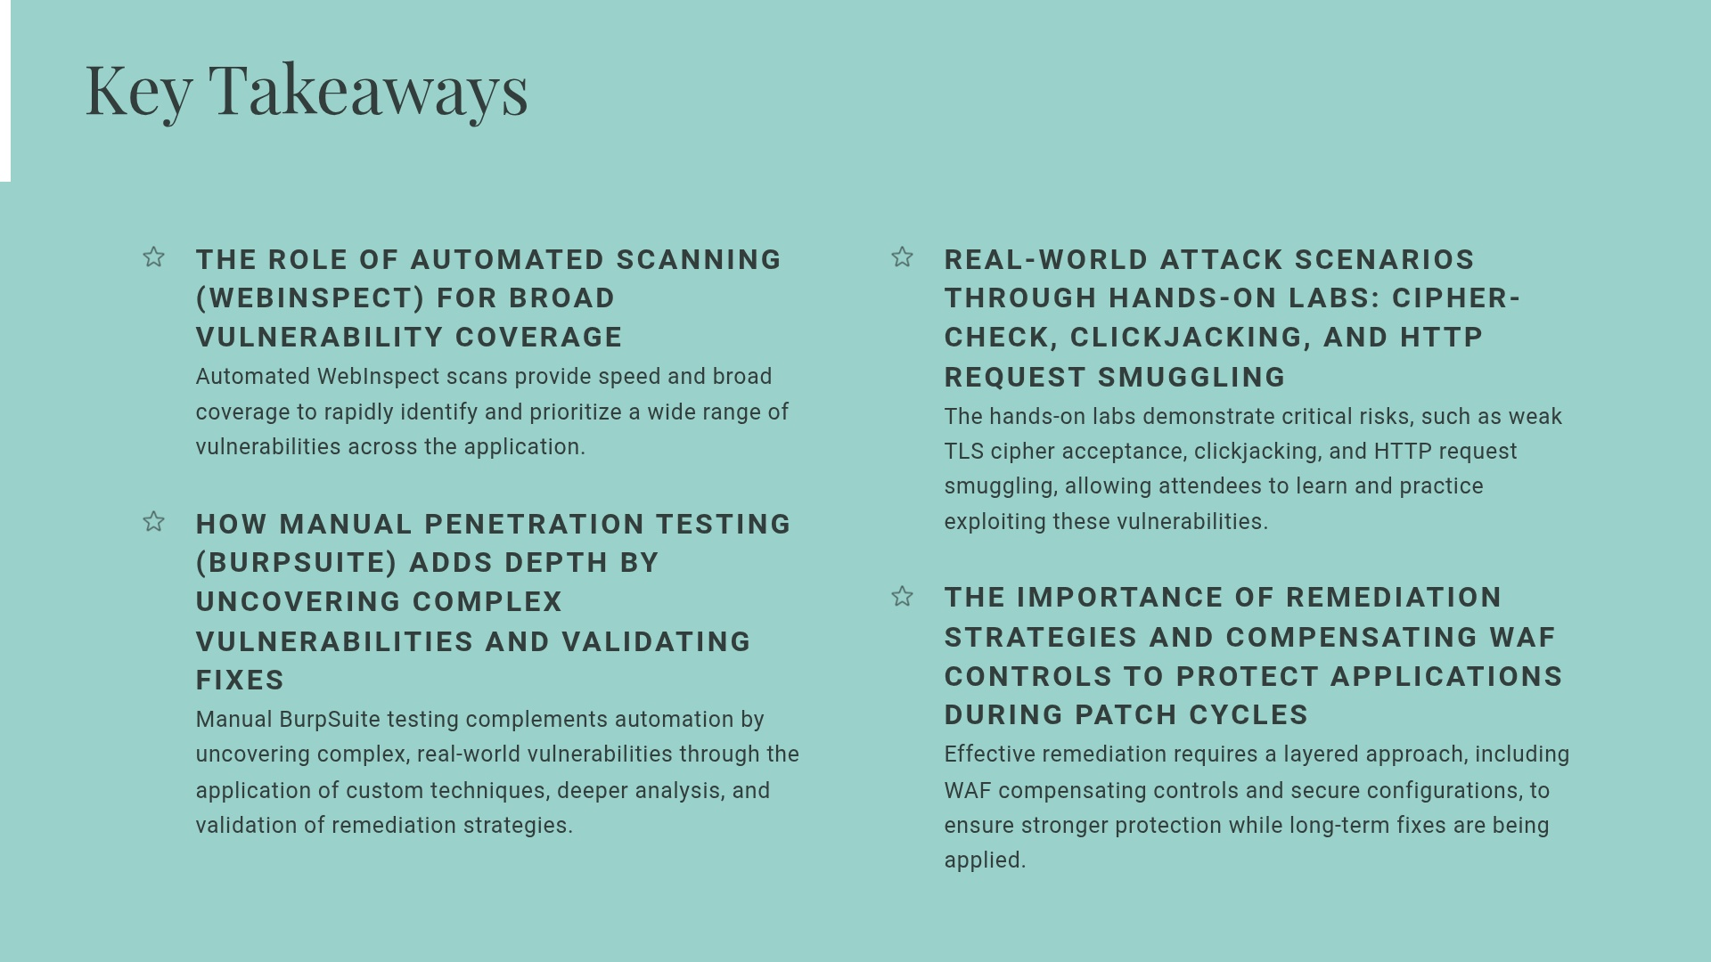
Key Takeaways
THE ROLE OF AUTOMATED SCANNING (WEBINSPECT) FOR BROAD VULNERABILITY COVERAGE
Automated WebInspect scans provide speed and broad coverage to rapidly identify and prioritize a wide range of vulnerabilities across the application.
HOW MANUAL PENETRATION TESTING (BURPSUITE) ADDS DEPTH BY UNCOVERING COMPLEX VULNERABILITIES AND VALIDATING FIXES
Manual BurpSuite testing complements automation by uncovering complex, real-world vulnerabilities through the application of custom techniques, deeper analysis, and validation of remediation strategies.
REAL-WORLD ATTACK SCENARIOS THROUGH HANDS-ON LABS: CIPHER-CHECK, CLICKJACKING, AND HTTP REQUEST SMUGGLING
The hands-on labs demonstrate critical risks, such as weak TLS cipher acceptance, clickjacking, and HTTP request smuggling, allowing attendees to learn and practice exploiting these vulnerabilities.
THE IMPORTANCE OF REMEDIATION STRATEGIES AND COMPENSATING WAF CONTROLS TO PROTECT APPLICATIONS DURING PATCH CYCLES
Effective remediation requires a layered approach, including WAF compensating controls and secure configurations, to ensure stronger protection while long-term fixes are being applied.

